Slide 1


http://www.comp.nus.edu.sg/~cs1010/
UNIT 10
Multidimensional Arrays

Slide 2

PROGRAMMING METHODOLOGY (PHƯƠNG PHÁP LẬP TRÌNH)
UNIT 10: Multidimensional Arrays

Slide 3
Acknowledgement
The contents of these slides have origin from School of Computing, National University of Singapore.
We greatly appreciate support from Mr. Aaron Tan Tuck Choy for kindly sharing these materials.

Slide 4
Policies for students
These contents are only used for students PERSONALLY.
Students are NOT allowed to modify or deliver these contents to anywhere or anyone for any purpose.

Slide 5
Recording of modifications
Currently, there are no modification on these contents.

Slide 6
Unit 10: Multidimensional Arrays
Objective:
Understand the concept and application of multi-dimensional arrays
Reference:
Chapter 6: Numeric Arrays

Slide 7
Unit 10: Multidimensional Arrays (1/2)
One-dimensional Arrays (review)
1.1 Print Array
1.2 Find Maximum Value
1.3 Sum Elements
1.4 Sum Alternate Elements
1.5 Sum Odd Elements
1.6 Sum Last 3 Elements
1.7 Minimum Pair Difference
1.8 Accessing 1D Array Elements in Function

Slide 8
Unit 10: Multidimensional Arrays (2/2)
Multi-dimensional Arrays
2.1 Initalizers
2.2 Example
2.3 Accessing 2D Array Elements in Function
2.4 Class Enrolment
2.5 Matrix Addition

Slide 9
1. One-dimensional Arrays (1/2)
Array
A collection of data, called elements, of homogeneous type
Element type
Array name
int
a
[6]
Array size
a[0]
a[1]
a[2]
a[3]
a[4]
a[5]
20
12
25
8
36
9

Slide 10
1. One-dimensional Arrays (2/2)
Preparing an array prior to processing:
Initialization (if values are known beforehand):
int main(void) {
int numbers[] = { 20, 12, 25, 8, 36, 9 };
...
}
some_fn(numbers, 6);
Or, read data into array:
int main(void) {
int numbers[6], i;
for (i = 0; i < 6; i++)
scanf("%d", &numbers[i]);
...
}
some_fn(numbers, 6);

Slide 11
1.1 Print Array
void printArray(int arr[], int size) {
int i;
for (i = 0; i < size; i++)
printf("%d ", arr[i]);
printf("\n");
}
Calling:
int main(void) {
int numbers[6];
...
printArray(numbers, 6);
printArray(numbers, 3);
}
Value must not exceed actual array size.
Print first 6 elements (all)
Print first 3 elements

Slide 12
1.2 Find Maximum Value
findMax(int arr[], int size) to return the maximum value in arr with size elements
Precond: size > 0
int findMax(int arr[], int size) {
int i, max;
max = arr[0];
for (i = 1; i < size; i++)
if (arr[i] > max)
max = arr[i];
return max;
}
i
arr
max
1
2
3
4
5
6
20
25
36
20
12
25
8
36
9

Slide 13
1.3 Sum Elements
sum(int arr[], int size) to return the sum of elements in arr with size elements
Precond: size > 0
int sum(int arr[], int size) {
int i, sum = 0;
for (i = 0; i < size; i++)
sum += arr[i];
return sum;
}
i
arr
sum
0
1
2
3
4
5
6
20
20
32
57
65
101
110
0
12
25
8
36
9

Slide 14
1.4 Sum Alternate Elements
sumAlt(int arr[], int size) to return the sum of alternate elements (1st, 3rd, 5th, etc.)
Precond: size > 0
int sum(int arr[], int size) {
int i, sum = 0;
for (i = 0; i < size; i++)
sum += arr[i];
return sum;
}
int sumAlt(int arr[], int size) {
int i, sum = 0;
for (i = 0; i < size; i+=2)
sum += arr[i];
return sum;
}
i
arr
sum
0
2
4
6
20
45
81
0
20
12
25
8
36
9

Slide 15
1.5 Sum Odd Elements
sumOdd(int arr[], int size) to return the sum of elements that are odd numbers
Precond: size > 0
int sumOdd(int arr[], int size) {
int i, sum = 0;
for (i = 0; i < size; i++)
if (arr[i]%2 == 1)
sum += arr[i];
return sum;
}
int sum(int arr[], int size) {
int i, sum = 0;
for (i = 0; i < size; i++)
sum += arr[i];
return sum;
}
i
arr
sum
0
1
2
3
4
5
6
20
25
0
34
12
25
8
36
9

Slide 16
1.6 Sum Last 3 Elements (1/3)
sumLast3(int arr[], int size) to return the sum of the last 3 elements among size elements
Precond: size ≥ 0
Examples:
numbers | sumLast3(numbers, size)
{ } | 0
{ 5 } | 5
{ 12, -3 } | 9
{ 20, 12, 25, 8, 36, 9 } | 53
{ -1, 2, -3, 4, -5, 6, -7, 8, 9, 10 } | 27

Slide 17
1.6 Sum Last 3 Elements (2/3)
Thinking…
Last 3 elements of an array arr
arr[size – 1]
arr[size – 2]
arr[size – 3]
A loop to iterate 3 times (hence, need a counter) with index starting at size – 1 and decrementing it in each iteration
int i, count = 0;
for (i = size - 1; count<3; i--) {
. . .
count++;
}
But what if there are fewer than 3 elements in arr?
int i, count = 0;
for (i = size - 1; (i >= 0) && (count<3) ; i--) {
. . .
count++;
}

Slide 18
1.6 Sum Last 3 Elements (3/3)
Complete function:
int sumLast3(int arr[], int size) {
int i, count = 0, sum = 0;
for (i = size - 1; (i>=0) && (count<3); i--) {
sum += arr[i];
count++;
}
return sum;
}

Slide 19
1.7 Minimum Pair Difference (1/3)
Is it true that all problems on 1D arrays can be solved by single loop? Of course not!
Write a function minPairDiff(int arr[], int size) that computes the minimum possible difference of any pair of elements in arr.
For simplicity, assume size > 1 (i.e. there are at least 2 elements in array).
numbers | minPairDiff(numbers, size)
{ 20, 12, 25, 8, 36, 9 } | 1
{ 431, 945, 64, 841, 783, 107, 598 } | 43

Slide 20
1.7 Minimum Pair Difference (2/3)
Thinking…
Eg: size = 5. Need to compute difference of
Outer loop index
i from 0 to size-2
Inner loop index
j from i+1 to size-1
arr[1]
arr[2]
arr[0]
Inner loop index
j from 1 to size-1
arr[3]
arr[4]
arr[2]
arr[1]
arr[3]
Inner loop index
j from 2 to size-1
arr[4]
arr[3]
Inner loop index
j from 3 to size-1
arr[2]
arr[4]
arr[3]
arr[4]
Inner loop index
j from 4 to size-1

Slide 21
1.7 Minimum Pair Difference (3/3)
The code…
Outer loop index
i from 0 to size-2
Inner loop index
j from i+1 to size-1
int minPairDiff(int arr[], int size) {
int i, j, diff, minDiff;
minDiff = abs(arr[0] – arr[1]); // init min diff.
for (i = 0; i < size-1; i++)
for (j = i+1; j < size; j++) {
diff = abs(arr[i] – arr[j]);
if (diff < minDiff)
minDiff = diff;
}
return minDiff;
}
This kind of nested loop is found in many applications involving 1D array, for example, sorting (to be covered later).
In fact, this problem can be solved by first sorting the array, then scan through the array once more to pick the pair of neighbours with the smallest difference.

Slide 22
Code Provided
Unit10_FindMax.c:
Section 1.2 Find Maximum Element
Unit10_SumElements.c:
Section 1.3 Sum Elements
Section 1.4 Sum Alternate Elements
Section 1.5 Sum Odd Elements
Section 1.6 Sum Last 3 Elements
Unit10_MinPairDiff.c:
Section 1.7 Minimum Pair Difference

Slide 23
1.8 Accessing 1D Array Elements in Function (1/2)
A function header with array parameter,
int sum(int a[ ], int size)
Why is it not necessary to have a value in here to indicate the “real” size?
A value is not necessary (and is ignored by compiler if provided) as accessing a particular array element requires only the following information
The address of the first element of the array
The size of each element
Both information are known
For example, when the above function is called with ans = sum(numbers, 6); in the main(), the address of the first element, &numbers[0], is copied into the parameter a
The size of each element is determined since the element type (int) is given (in sunfire, an integer takes up 4 bytes)

Slide 24
1.8 Accessing 1D Array Elements in Function (2/2)
A function header with array parameter,
int sum(int a[ ], int size)
Why is it not necessary to have a value in here to indicate the “real” size?
With this, the system is able to calculate the effective address of the required element, say a[2], by the following formula:
Address of a[2] = base address + (2 × size of each element)
where base address is the address of the first element
Hence, suppose the base address is 2400, then address of a[2] is 2400 + (2 × 4), or 2408.
a[0]
a[1]
a[2]
a[3]
5
19
12
7
...

Slide 25
2. Multi-dimensional Arrays (1/2)
In general, an array can have any number of dimensions
Example of a 2-dimensional (2D) array:
// array with 3 rows, 5 columns
int a[3][5];
a[0][0] = 2;
a[2][4] = 9;
a[1][0] = a[2][4] + 7;
0
1
2
3
4
0
2
1
16
2
9
Arrays are stored in row-major order
That is, elements in row 0 comes before row 1, etc.
a[0][0]
…
a[0][4]
a[1][0]
…
a[1][4]
a[2][0]
…
a[2][4]
row 0
row 1
row 2

Slide 26
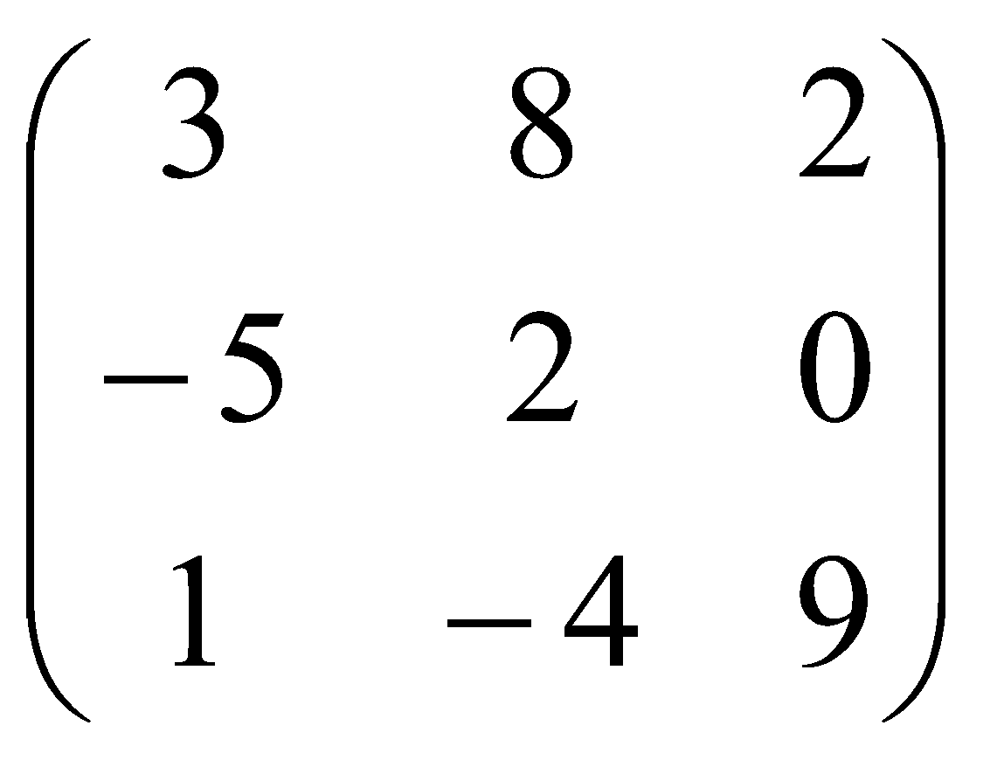
2. Multi-dimensional Arrays (2/2)
Examples of applications:
1
2
3
…
30
31
Jan
32.1
31.8
31.9
32.3
32.4
Feb
32.6
32.6
33.0
…
0
0
:
matrix[3][3]
Dec
31.8
32.3
30.9
31.6
32.2
Daily temperatures: temperatures[12][31]
Jerna
Suise
Zass
Ex1
Ex2
Ex3
Ex1
Ex2
Ex3
Emily
Ex1
Ex2
Ex3
Lab1
79
75
66
Lab1
52
50
45
Ex1
Ex2
Ex3
Lab1
59
68
60
Lab2
90
83
77
Lab2
57
60
63
Lab1
76
80
62
Lab2
0
0
0
Lab3
81
73
79
Lab3
52
59
66
Lab2
60
72
48
Lab3
67
71
75
Lab4
58
64
52
Lab4
33
42
37
Lab3
76
80
62
Lab4
38
52
35
Lab5
93
80
85
Lab5
68
68
72
Lab4
60
72
48
Lab5
78
86
82
Lab5
58
79
73
Students’ lab marks: marks[4][5][3]

Slide 27
2.1 Multi-dimensional Array Initializers
Examples:
// nesting one-dimensional initializers
int a[3][5] = { {4, 2, 1, 0, 0},
{8, 3, 3, 1, 6},
{0, 0 ,0, 0, 0} };
// the first dimension can be unspecified
int b[][5] = { {4, 2, 1, 0, 0},
{8, 3, 3, 1, 6},
{0, 0, 0, 0, 0} };
// initializer with implicit zero values
int d[3][5] = { {4, 2, 1},
{8, 3, 3, 1, 6} };
What happens to the uninitialized elements?

Slide 28
2.2 Multi-dimensional Array: Example
Unit10_2DArray.c
#include <stdio.h>
#define N 5 // number of columns in array
int sumArray(int [][N], int); // function prototype
int main(void) {
int foo[][N] = { {3,7,1}, {2,1}, {4,6,2} };
printf("Sum is %d\n", sumArray(foo, 3));
printf("Sum is %d\n", sumArray(foo, 2));
return 0;
}
// To sum all elements in arr
int sumArray(int arr[][N], int rows) {
int i, j, total = 0;
for (i = 0; i < rows; i++) {
for (j = 0; j < N; j++) {
total += arr[i][j];
}
}
return total;
}
Second dimension must be specified; first dimension is not required.
Sum is 26
Sum is 14

Slide 29
2.3 Accessing 2D Array Elements in Function
A function header with 2D array parameter,
function(int a[][5], ...)
Why second dimension must be specified, but not the first dimension?
To access an element in a 2D array, it must know the number of columns. It needs not know the number of rows.
For example, given the following two 2D-arrays:
A 3-column 2D array:
A 5-column 2D array:
:
:
As elements are stored linearly in memory in row-major order, element a[1][0] would be the 4th element in the 3-column array, whereas it would be the 6th element in the 5-column array.
Hence, to access a[1][0] correctly, we need to provide the number of columns in the array.
For multi-dimensional arrays, all but the first dimension must be specified in the array parameter.

Slide 30
2.4 Class Enrolment (1/5)
A class enrolment system can be represented by a 2D array enrol, where the rows represent the classes, and columns the students. For simplicity, classes and students are identified by non-negative integers.
A ‘1’ in enrol[c][s] indicates student s is enrolled in class c; a ‘0’ means s is not enrolled in c.
Assume at most 10 classes and 30 students.
Example of an enrolment system with 3 classes and 8 students:
0
1
2
3
4
5
6
7
Queries:
Name any class with the most number of students
Name all students who are enrolled in all the classes
0
1
0
1
0
1
1
1
0
1
1
0
1
1
1
0
1
1
2
0
1
1
1
0
0
1
0

Slide 31
2.4 Class Enrolment (2/5)
Inputs:
Number of classes and students
Number of data entries
Each data entry consists of 2 integers s and c indicating that student s is enrolled in class c.
Sample input:
Number of classes and students: 3 8
Number of data entries: 15
Enter 15 entries (student class):
3 1
0 0
0 1
1 2
2 0
2 1
2 2
3 2
7 1
6 0
5 0
4 1
4 0
6 2
6 1
0
1
2
3
4
5
6
7
0
1
0
1
0
1
1
1
0
1
1
0
1
1
1
0
1
1
2
0
1
1
1
0
0
1
0

Slide 32
2.4 Class Enrolment (3/5)
#define MAX_CLASSES 10
#define MAX_STUDENTS 30
int main(void) {
int enrol[MAX_CLASSES][MAX_STUDENTS] = { {0} }, numClasses, numStudents;
printf("Number of classes and students: ");
scanf("%d %d", &numClasses, &numStudents);
readInputs(enrol, numClasses, numStudents);
return 0;
}
// Read data into array enrol
void readInputs(int enrol[][MAX_STUDENTS],
int numClasses, int numStudents) {
int entries; // number of data entries
int i, class, student;
printf("Number of data entries: ");
scanf("%d", &entries);
printf("Enter %d data entries (student class): \n", entries);
// Read data into array enrol
for (i = 0; i < entries; i++) {
scanf("%d %d", &student, &class);
enrol[class][student] = 1;
}
}
3 8
1 5
3 1
0 0
0 1
1 2
2 0
2 1
2 2
3 2
7 1
6 0
5 0
4 1
4 0
6 2
6 1
0
1
2
3
4
5
6
7
0
1
0
1
0
1
1
1
0
1
1
0
1
1
1
0
1
1
2
0
1
1
1
0
0
1
0

Slide 33
2.4 Class Enrolment (4/5)
Query 1: Name any class with the most number of students
Row sums
int classWithMostStudents
(int enrol[][MAX_STUDENTS],
int numClasses, int numStudents) {
int classSizes[MAX_CLASSES];
int r, c; // row and column indices
int maxClass, i;
for (r = 0; r < numClasses; r++)
classSizes[r] = 0;
for (c = 0; c < numStudents; c++) {
classSizes[r] += enrol[r][c];
}
// find the one with most students
maxClass = 0; // assume class 0 has most students
for (i = 1; i < numClasses; i++)
if (classSizes[i] > classSizes[maxClass])
maxClass = i;
return maxClass;
}
0
1
2
3
4
5
6
7
0
1
0
1
0
1
1
1
0
5
6
4
1
1
0
1
1
1
0
1
1
2
0
1
1
1
0
0
1
0

Slide 34
2.4 Class Enrolment (5/5)
Query 2: Name all students who are enrolled in all classes
0
1
2
3
4
5
6
7
// Find students who are enrolled in all classes
void busiestStudents(int enrol[][MAX_STUDENTS],
int numClasses, int numStudents) {
int sum;
int r, c;
printf("Students who take all classes: ");
for (c = 0; c < numStudents; c++) {
sum = 0;
for (r = 0; r < numClasses; r++) {
sum += enrol[r][c];
}
if (sum == numClasses)
printf("%d ", c);
}
printf("\n");
}
0
1
0
1
0
1
1
1
0
1
1
0
1
1
1
0
1
1
2
0
1
1
1
0
0
1
0
2 1 3 2 2 1 3 1
Column sums
Refer to Unit10_ClassEnrolment.c for complete program.

Slide 35
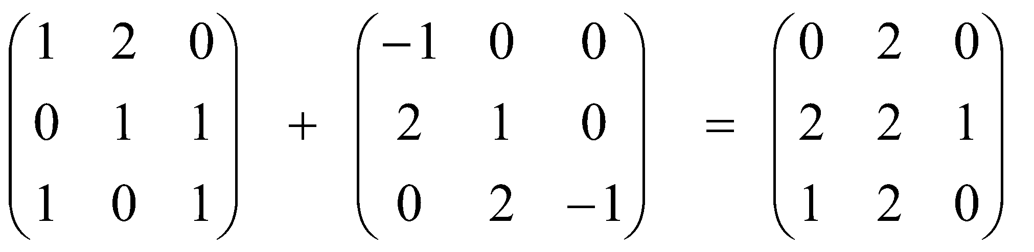
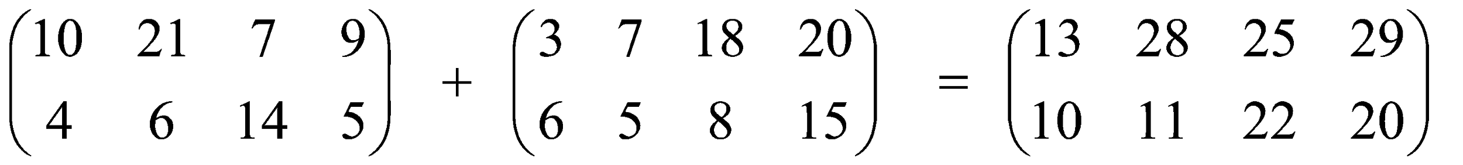
2.5 Matrix Addition (1/2)
To add two matrices, both must have the same size (same number of rows and columns).
To compute C = A + B, where A, B, C are matrices
c_{i,j} = a_{i,j} + b_{i,j}
Examples:

Slide 36
2.5 Matrix Addition (2/2)
Unit10_MatrixOps.c
// To sum mtxA and mtxB to obtain mtxC
void sumMatrix(float mtxA[][MAX_COL], float mtxB[][MAX_COL],
float mtxC[][MAX_COL], int row_size, int col_size) {
int row, col;
for (row=0; row<row_size; row++)
for (col=0; col<col_size; col++)
mtxC[row][col] = mtxA[row][col] + mtxB[row][col];
}
10
21
7
9
3
7
18
20
?
13
?
28
?
25
?
29
+
=
4
6
14
5
6
5
8
15
?
10
?
11
?
22
?
20

Slide 37
Summary
In this unit, you have learned about
Declaring 2D arrays
Using 2D arrays in problem solving

Slide 38
End of File

